Slide 1


Reverse Engineering

Slide 2

What is reverse engineering?
The process of taking a piece of software or hardware and analyzing its functions and information flow so that its functionality and behavior can be understood.

Slide 3
Brief intro to Assembly
What happens when you compile?
The code is converted into series of operations which will be executed by the computer.
Trying to understand the instructions by reading the opcode is almost impossible.
Assembly is used to translate these instructions to human readable and makes it easier to understand

Slide 4
Resources
https://www.tutorialspoint.com/assembly_programming/index.html
https://www.varonis.com/blog/stack-memory-3
https://www.youtube.com/watch?v=75gBFiFtAb8
https://www.youtube.com/watch?v=ygOqZzATxNQ
https://www.youtube.com/watch?v=Wbm-a-7zc4g
https://www.youtube.com/watch?v=fTGTnrgjuGA
https://www.youtube.com/watch?v=VroEiMOJPm8
https://www.youtube.com/watch?v=moqv-hb-8To

Slide 5
Data types
Bit (0 or 1)
Byte = 8 bits
Word = 2 Bytes
dword = 2 words (double words)
qword = 4 words (quad words)

Slide 6
Registers
Small storage areas in the processor that can be used to store memory addresses or values.
General purpose registers:
32 bits : EAX EBX ECX EDX
16 bits : AX BX CX DX
8 bits : AH AL BH BL CH CL DH DL
EAX,AX,AH,AL : Called the Accumulator register.
EBX,BX,BH,BL : Called the Base register
ECX,CX,CH,CL : Called the Counter register
EDX,DX,DH,DL : Called the Data register
ESI EDI SI : Source index register Used for string and memory array copying

Slide 7
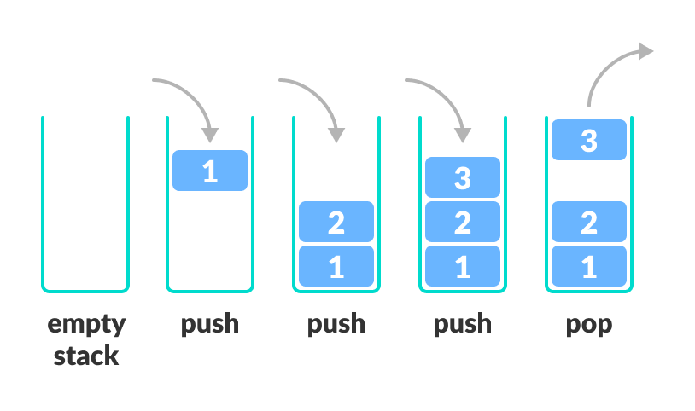
Stack
Is a data structure, where elements are entered and removed using push and pop functions.

Slide 8

EBP EBP BP : Stack Base pointer register Holds the base address of the stack
ESP ESP SP : Stack pointer register Holds the top address of the stack
EIP EIP IP : Index Pointer Holds the offset of the next instruction It can only be read

Slide 9
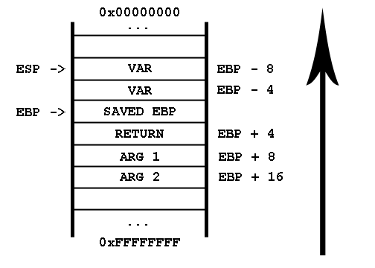

Slide 10
Basic instructions
add — Integer Addition
add eax, 10
EAX ← EAX + 10
sub — Integer Subtraction
sub eax, 216 — subtract 216 from the value stored in EAX
inc, dec — Increment, Decrement
dec eax — subtract one from the contents of EAX.

Slide 11
mov — Move
mov eax, ebx — copy the value in ebx into eax
push — Push stack
push eax — push eax on the stack
pop — Pop stack
pop edi — pop the top element of the stack into EDI.
lea — Load effective address
lea eax, [var] — the value in var is placed in EAX.

Slide 12
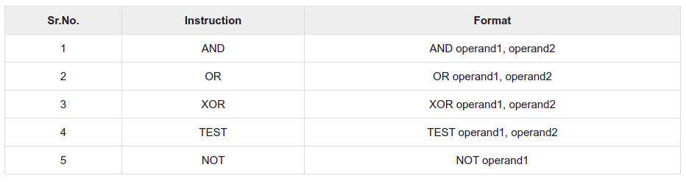
Logical instructions

Slide 13
Control flow instructions
jmp — Jump
Transfers program control flow to the instruction at the memory location indicated by the operand.
cmp — Compare
jcondition — Conditional Jump
cmp eax, ebx jle done
If the contents of EAX are less than or equal to the contents of EBX, jump to the label done. Otherwise, continue to the next instruction.

